Slide 1
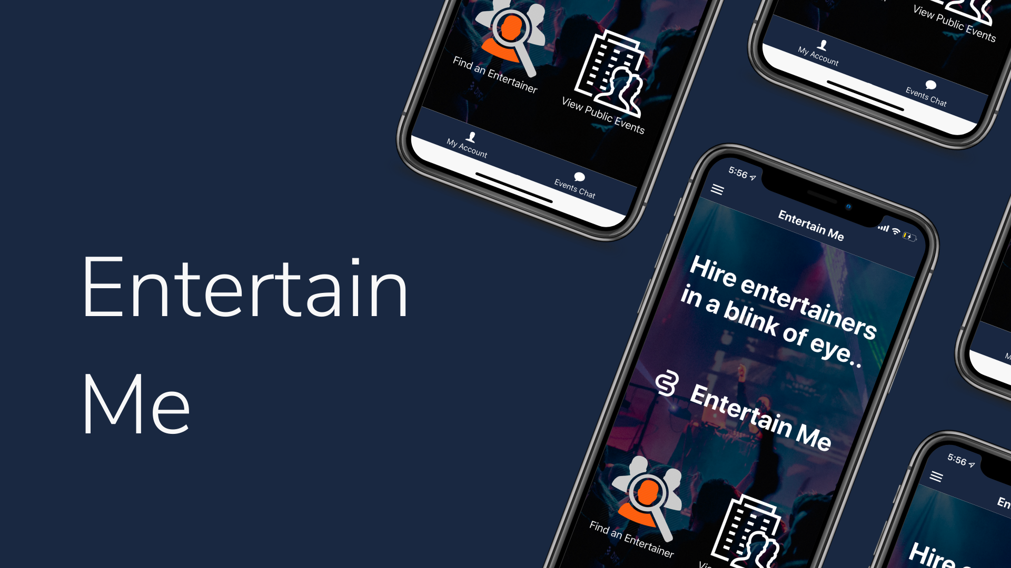

Slide 2
Team Members
Karthika Jayaprakash
Sai Anand Mohan
Prakhathi Murugesan
Suhash Bollu

Slide 3
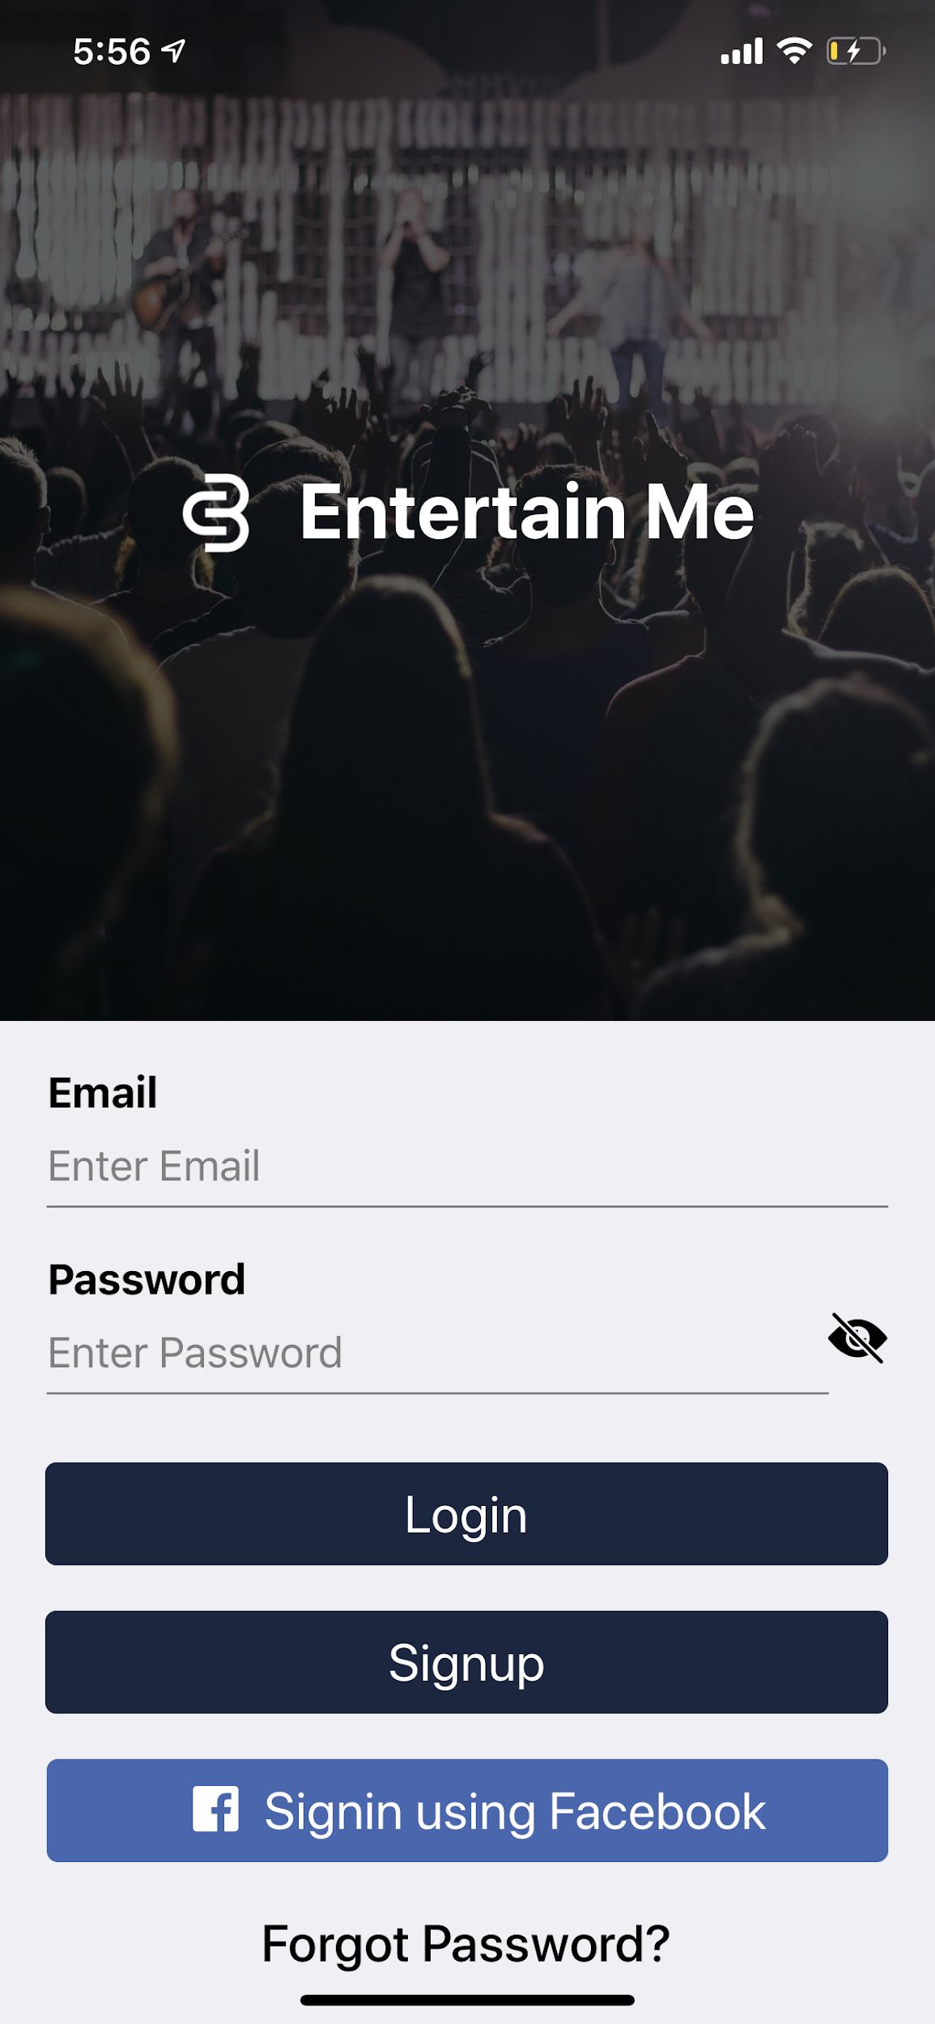
LOGIN

Slide 4
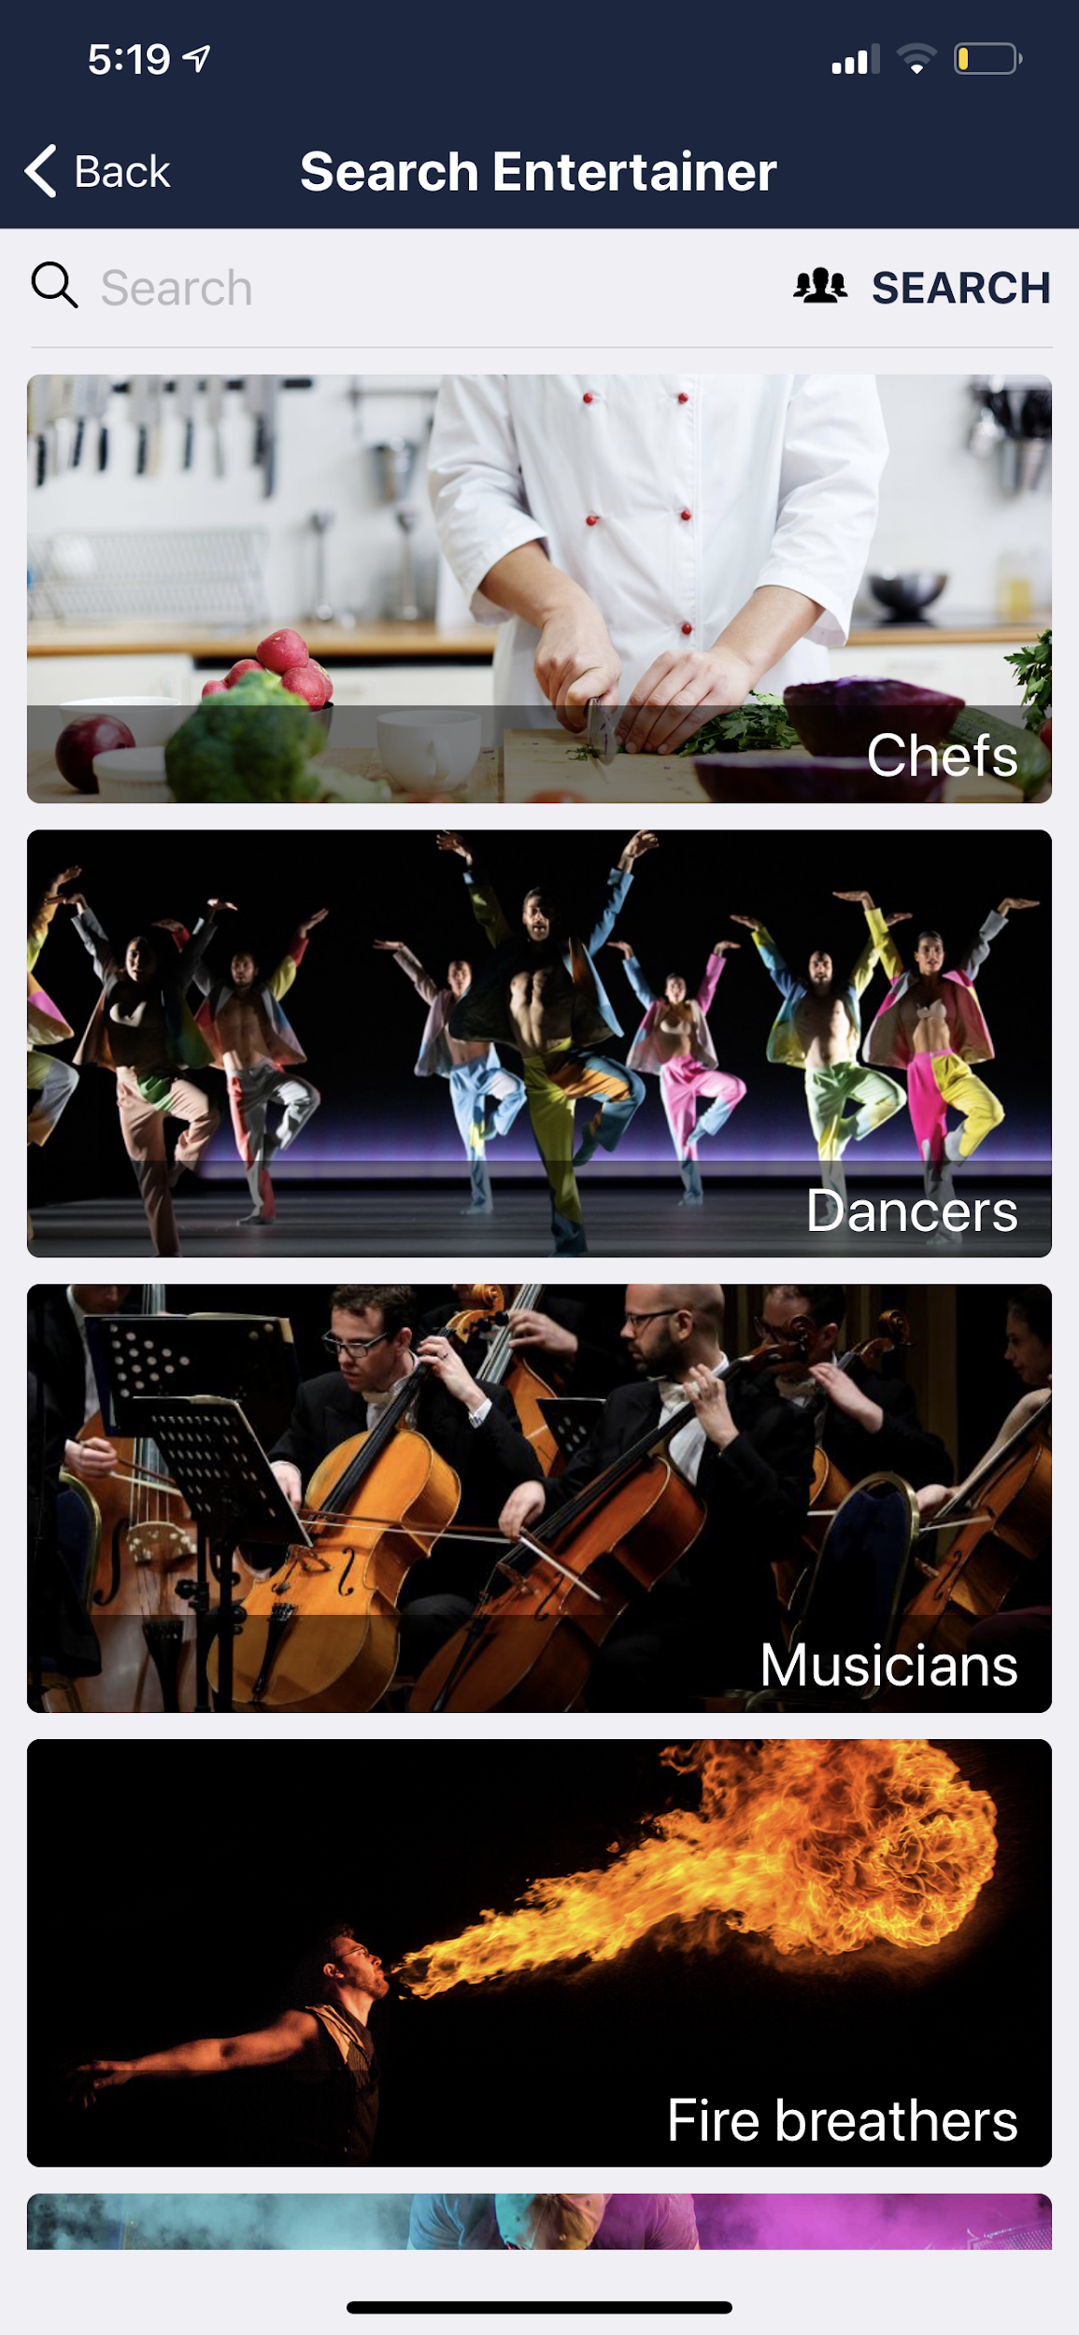
Search Entertainer
Book Entertainers

Slide 5
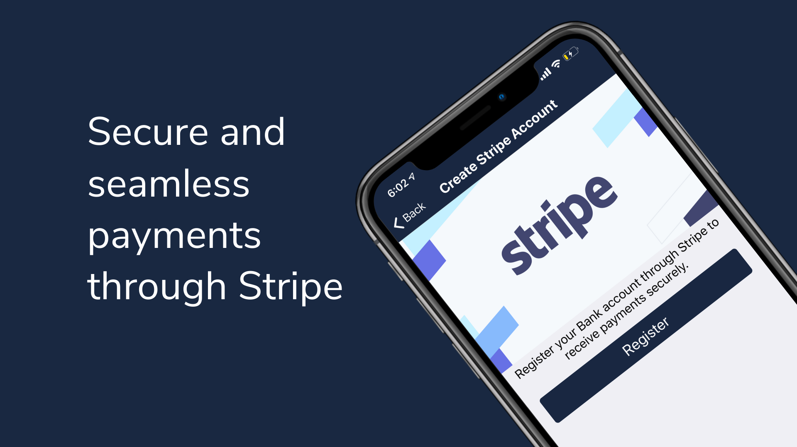

Slide 6
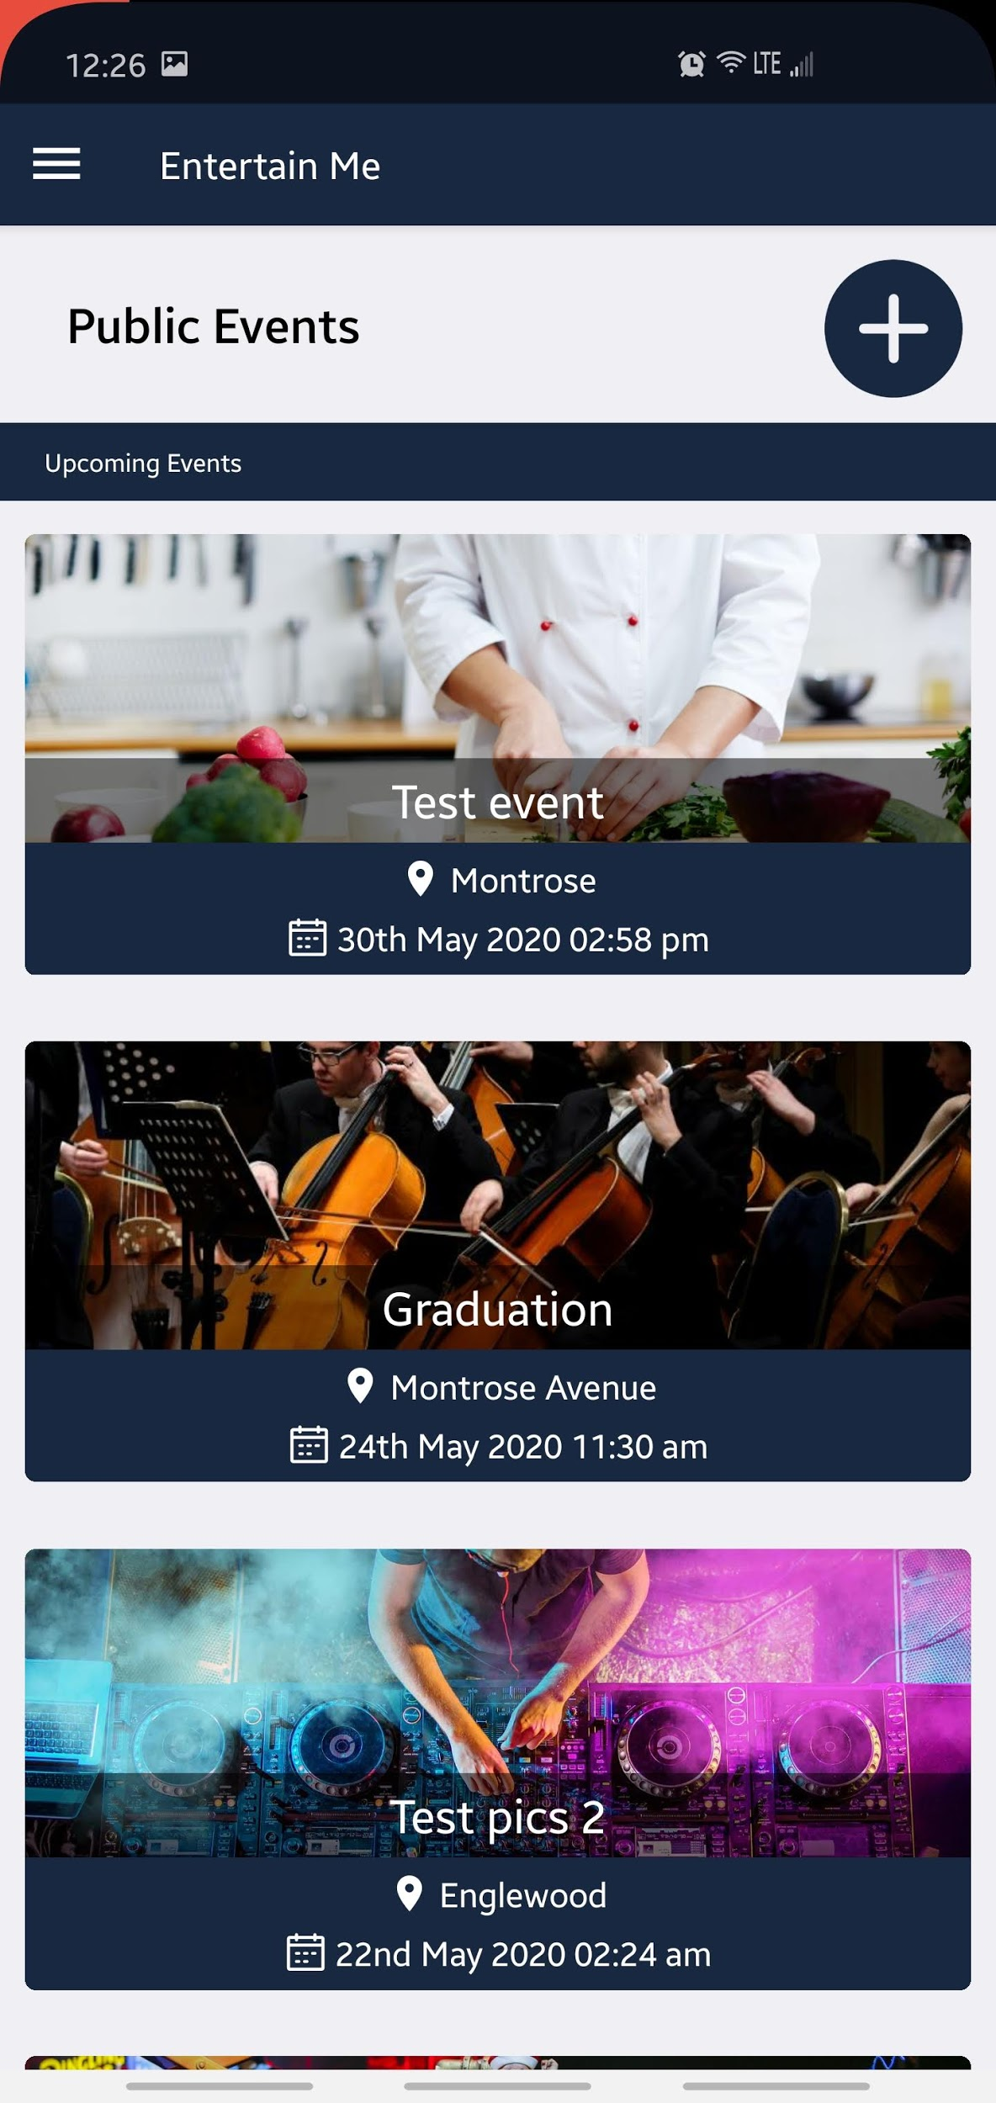
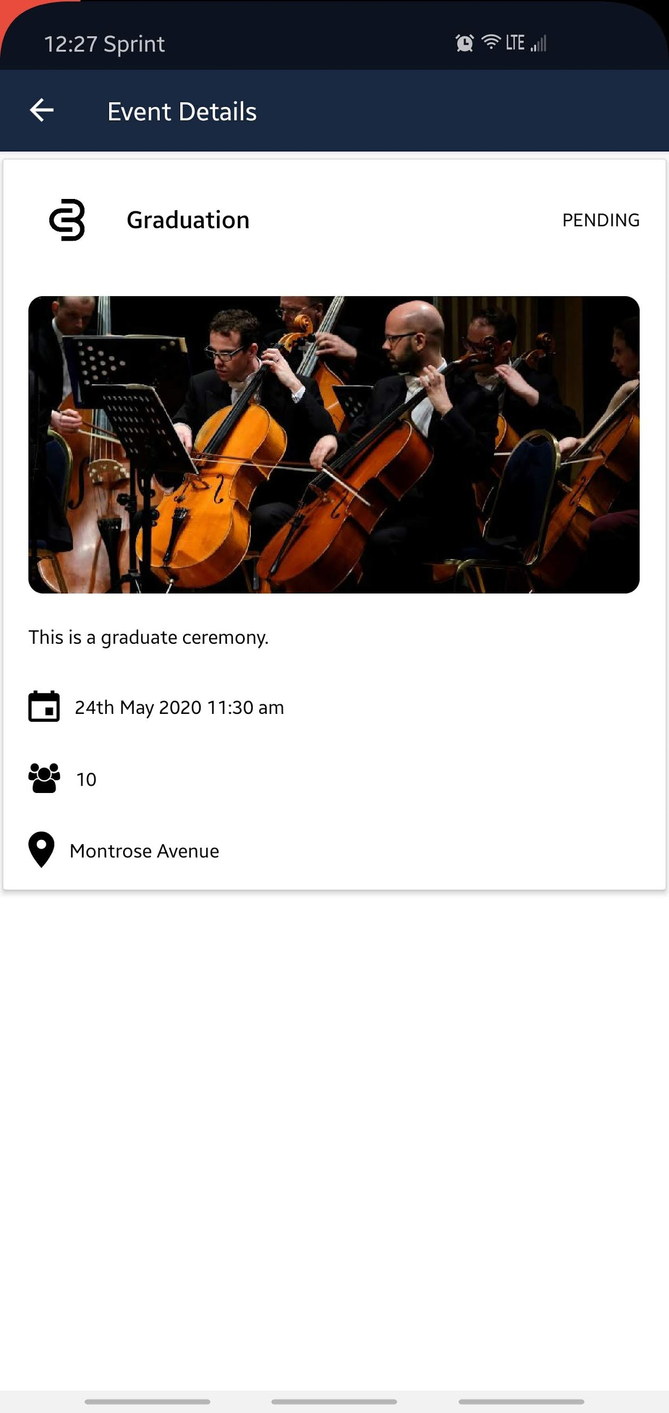
View Public Events

Slide 7
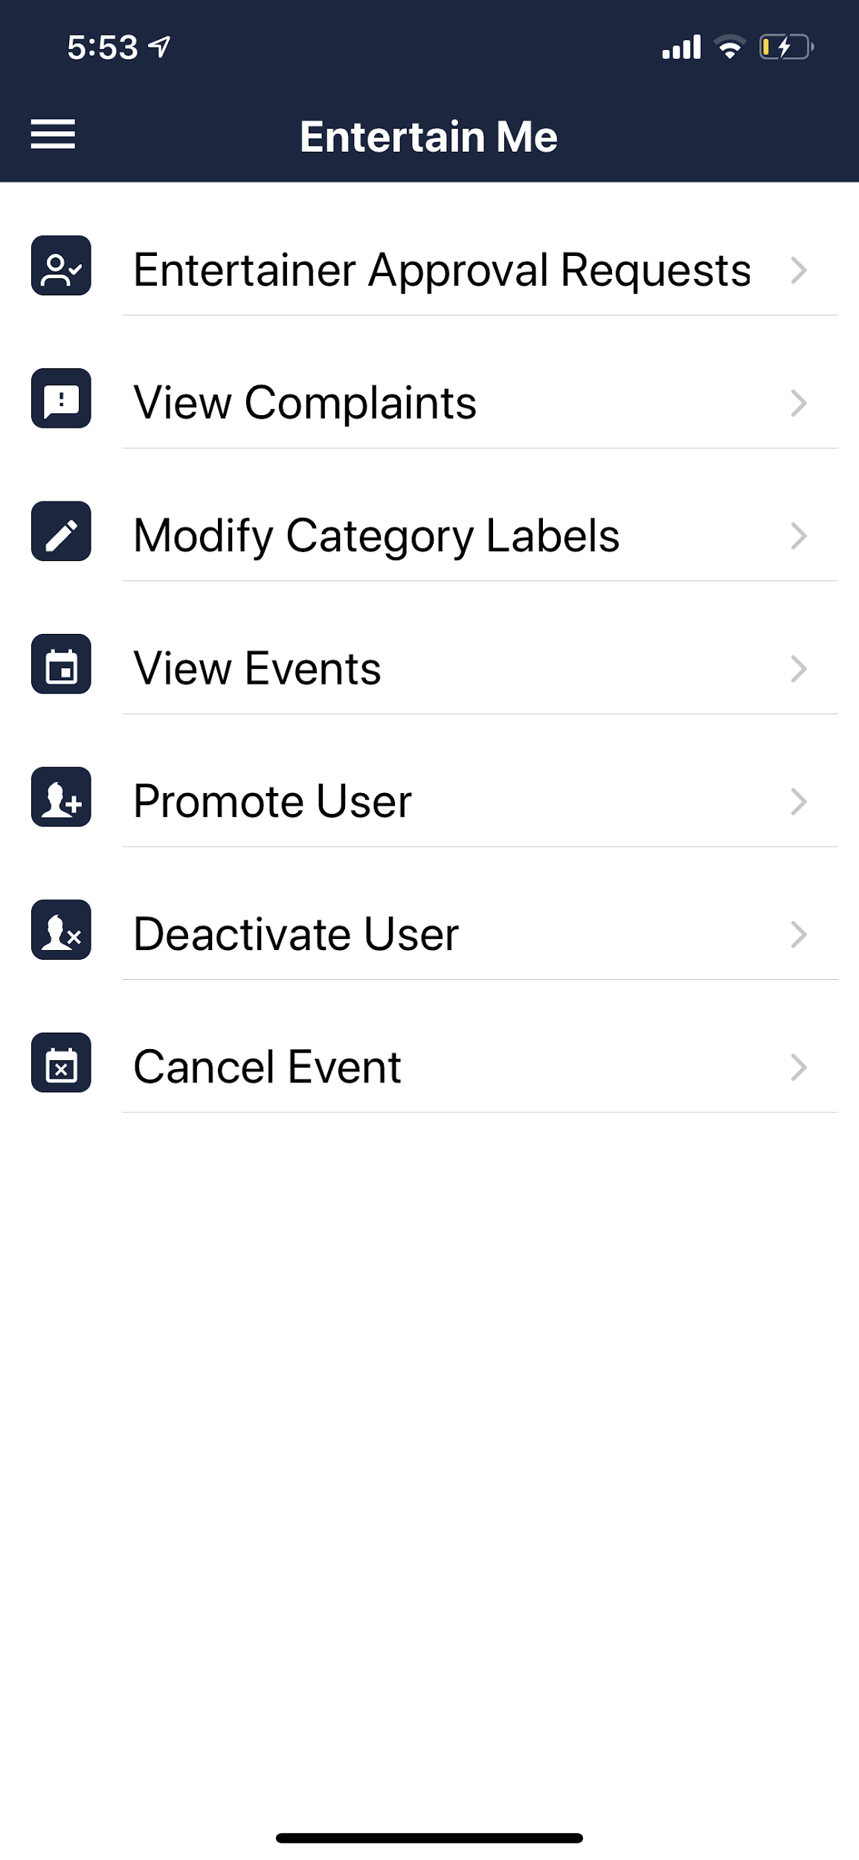
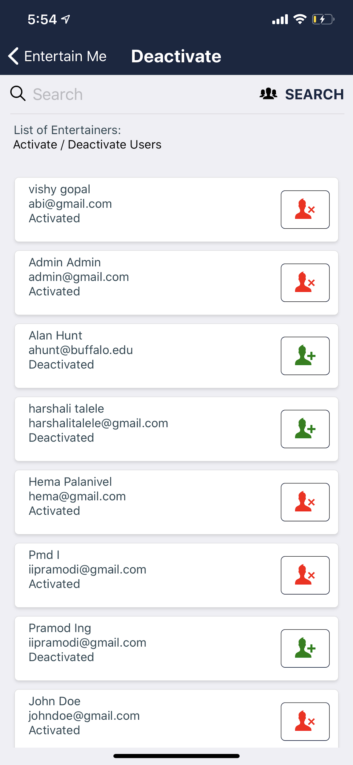
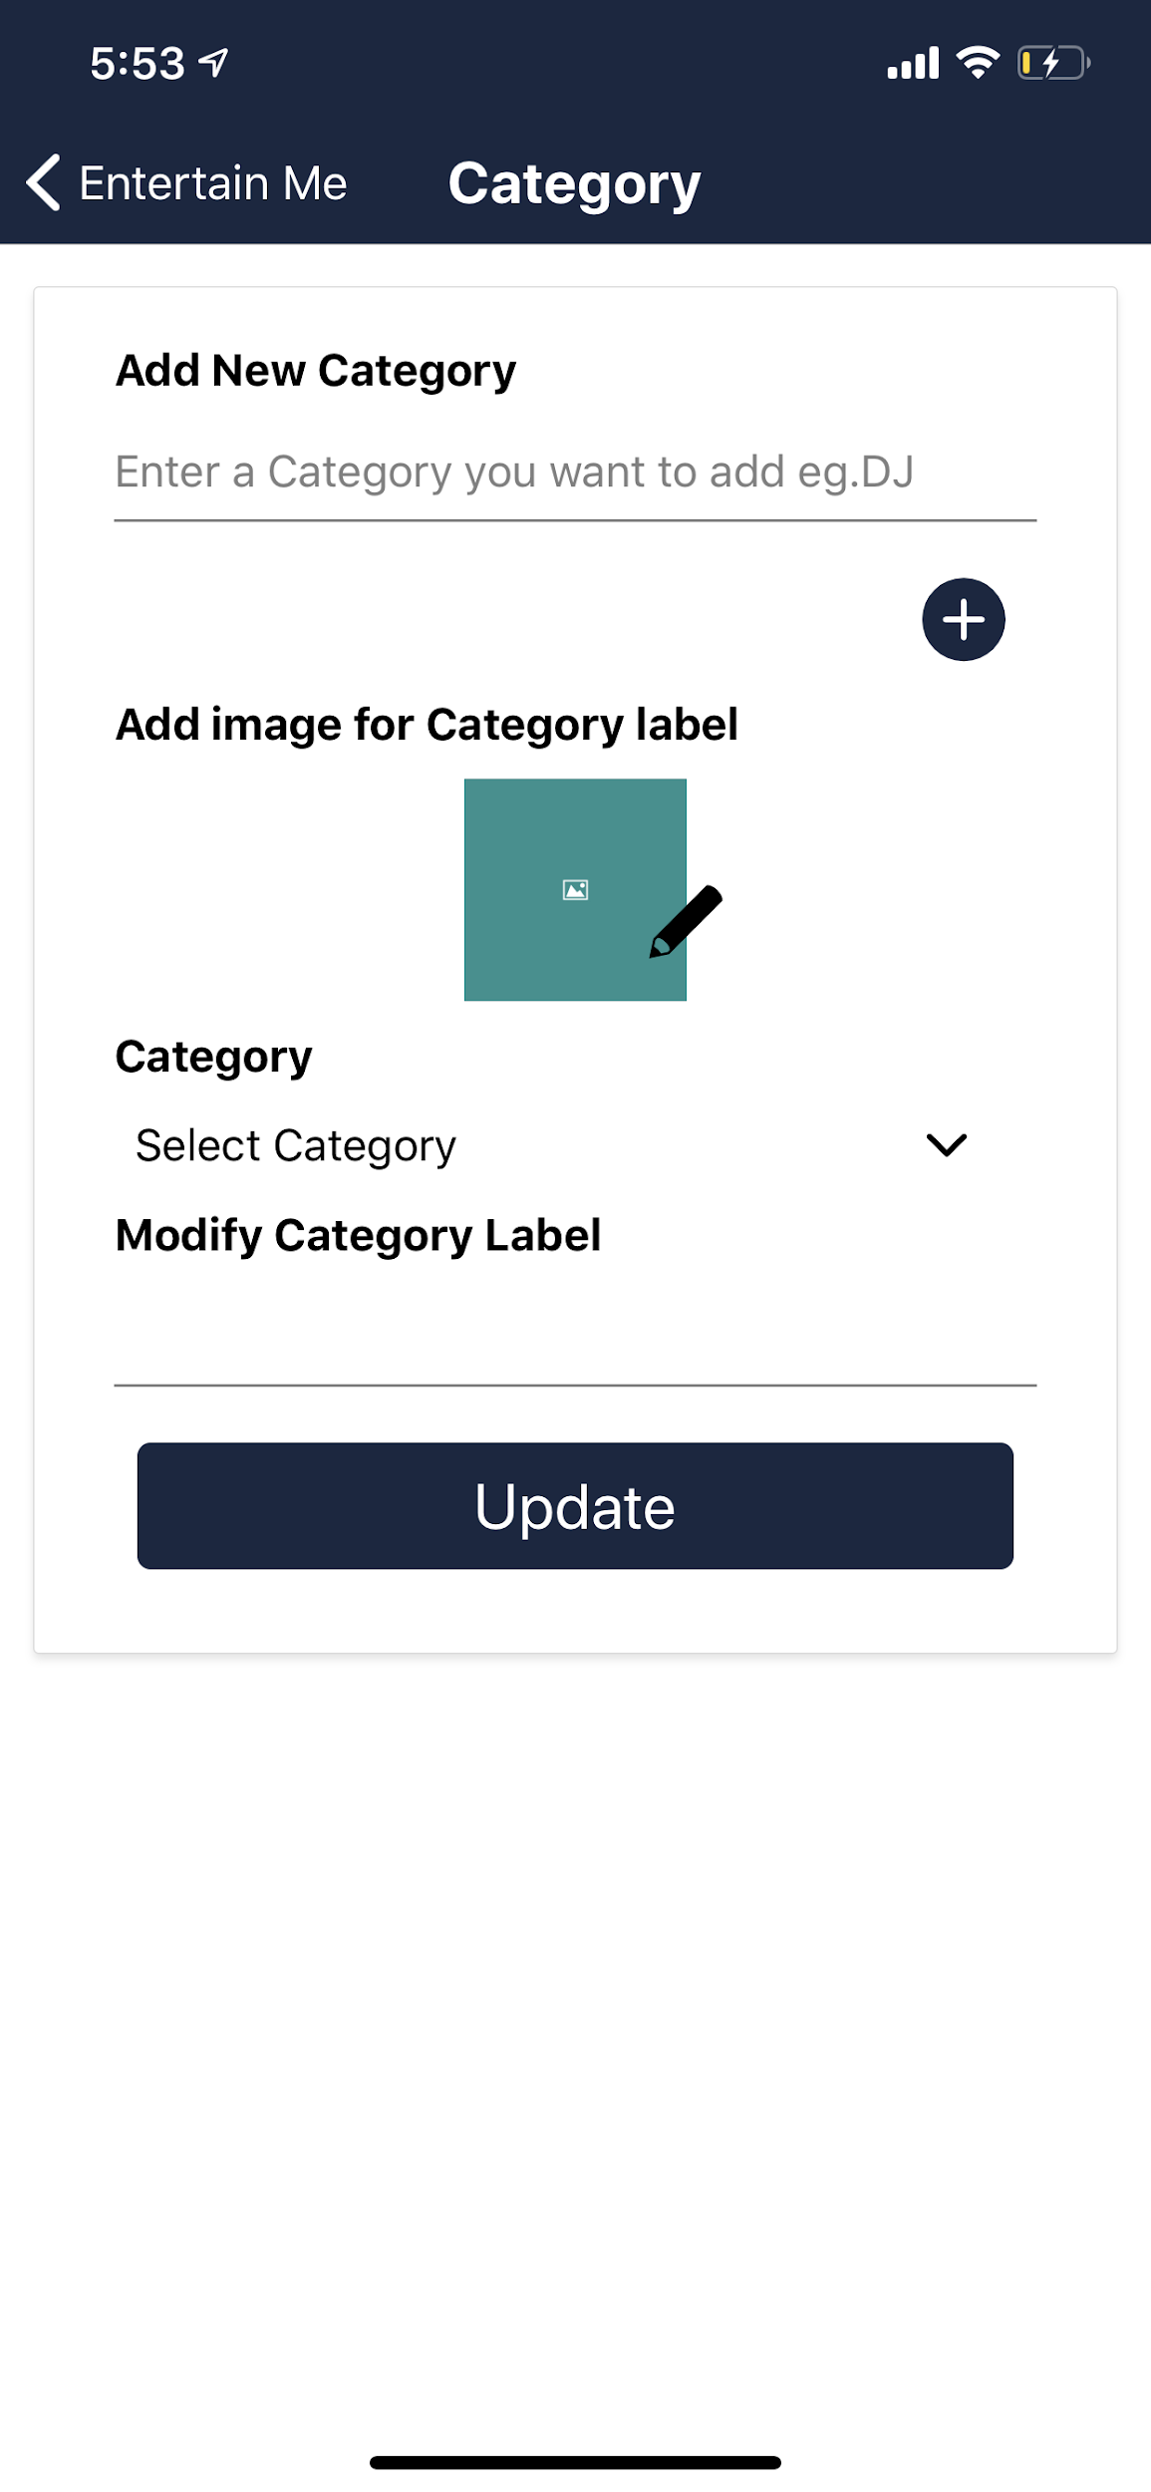
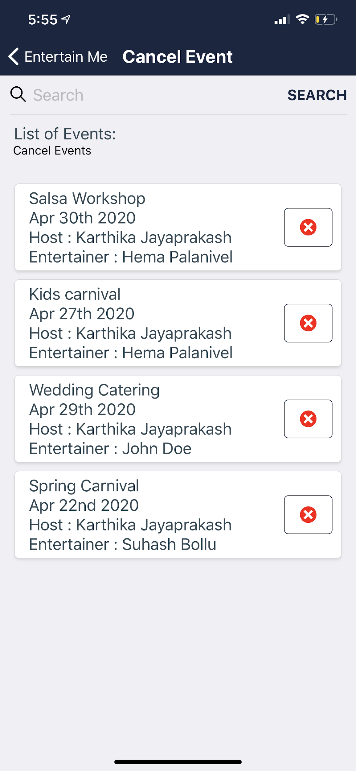
Administrator Functionalities

Slide 8
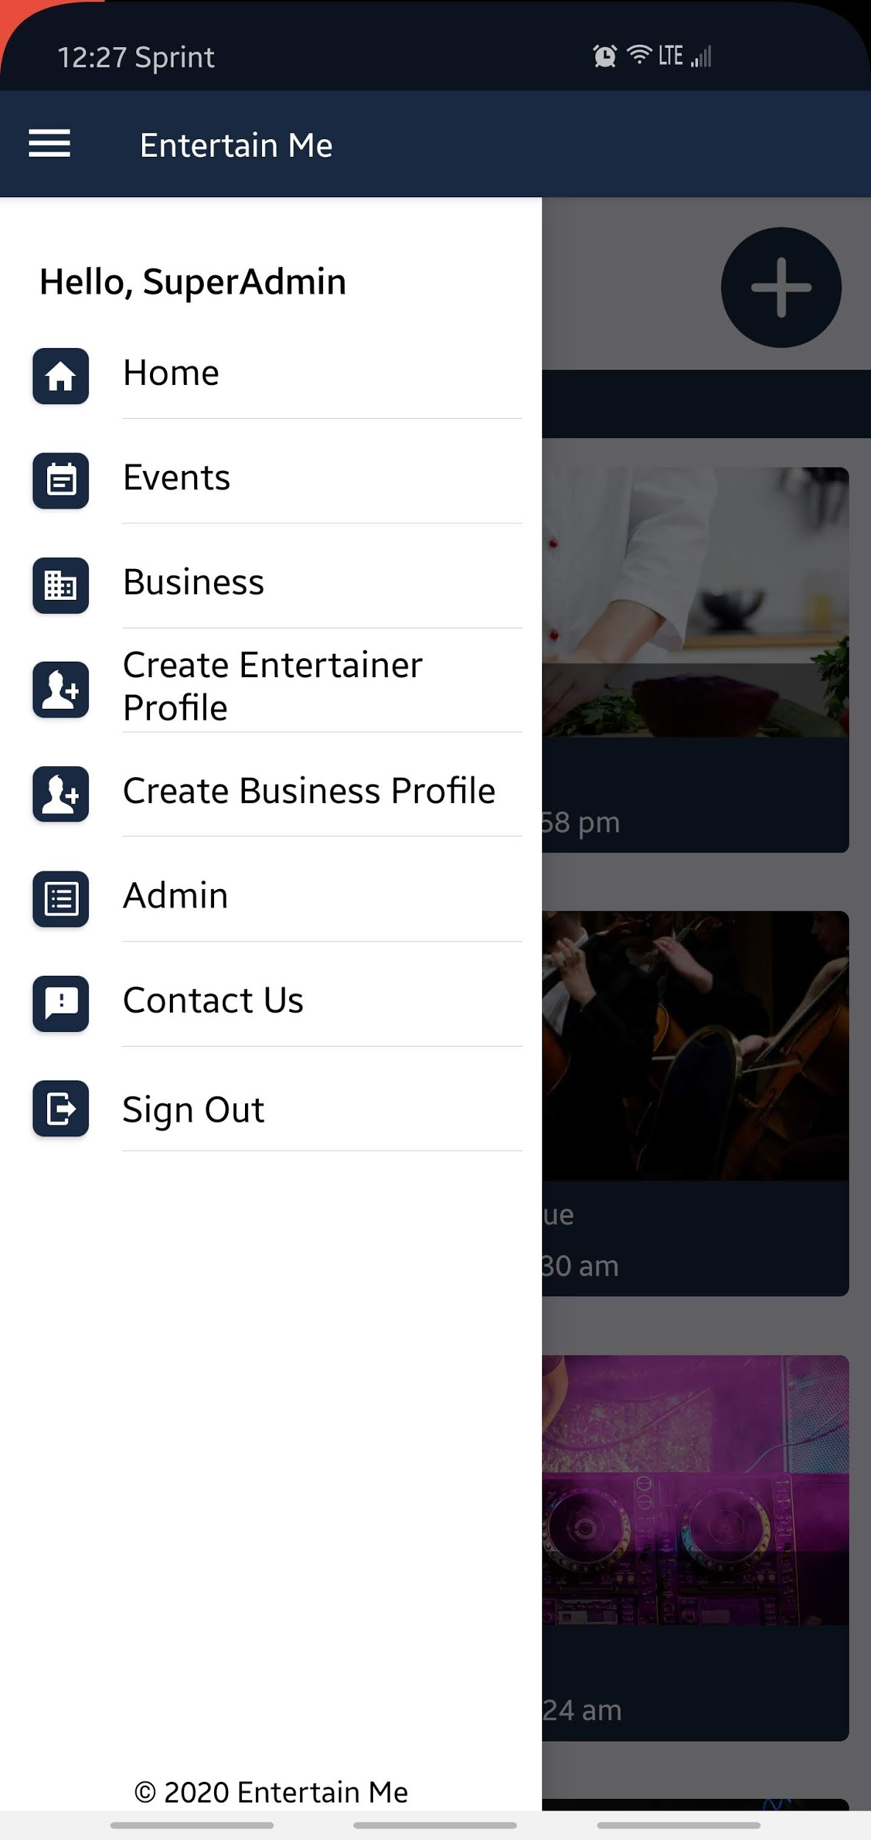
Side Navigation

Slide 9
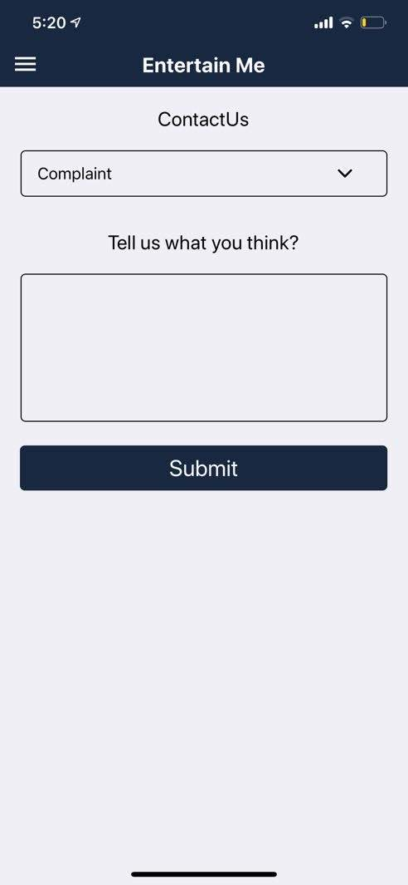
Feedback

Slide 10
Challenges Faced

Slide 11
THANK YOU

